Slide 1
Final Project DVD Rental Business Analysis
Prepared by
SIVA THARANI G M
BADM - MBE13

Slide 2

OVERALL SUMMARY
DVD Rental Business Analysis is done by using Descriptive analysis, Power BI and PostgreSQL.
The consolidated table is derived by PostgreSQL, Power BI query editor is used & visualizations is made by power bi report - descriptive statistics with actionable insights.

Slide 3

Preparation of Dataset
Using the given Entity-Relationship Diagram (ERD), a number of PostgreSQL tables were joined to create the dataset.
To create a consolidated table, the queries were provided.

Slide 4

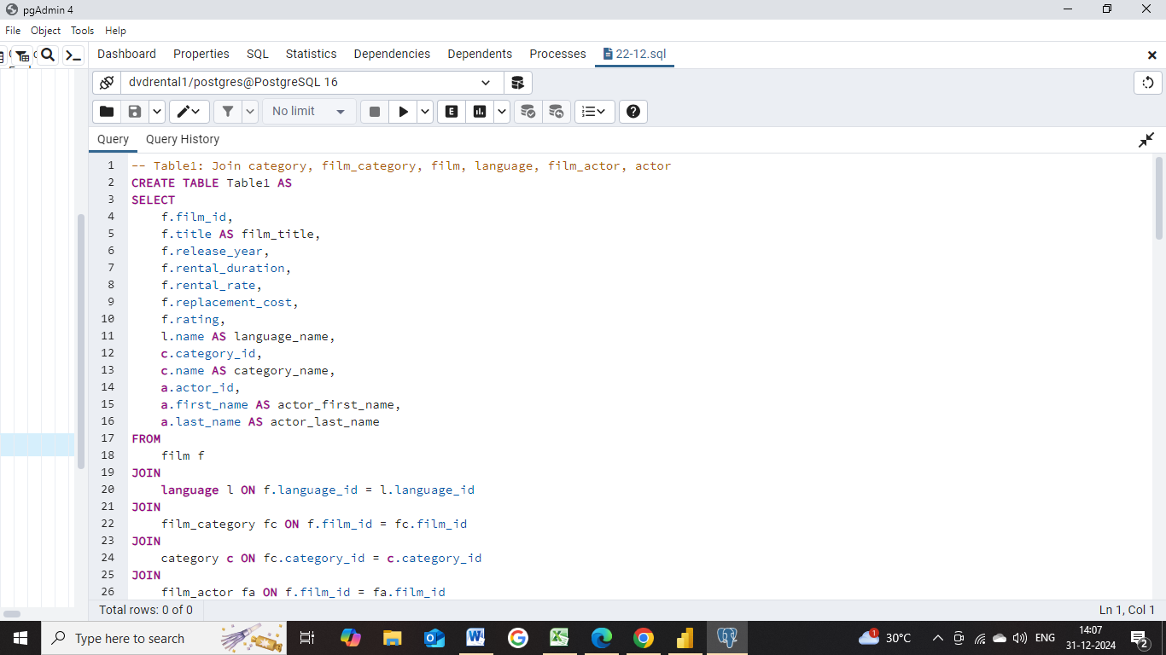
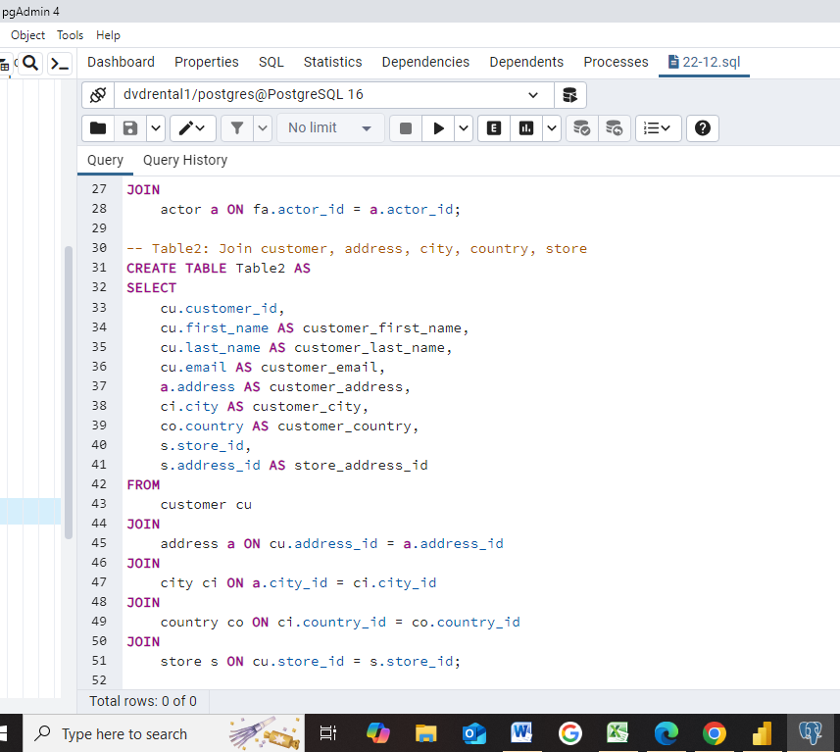
PostgreSQL query

Slide 5
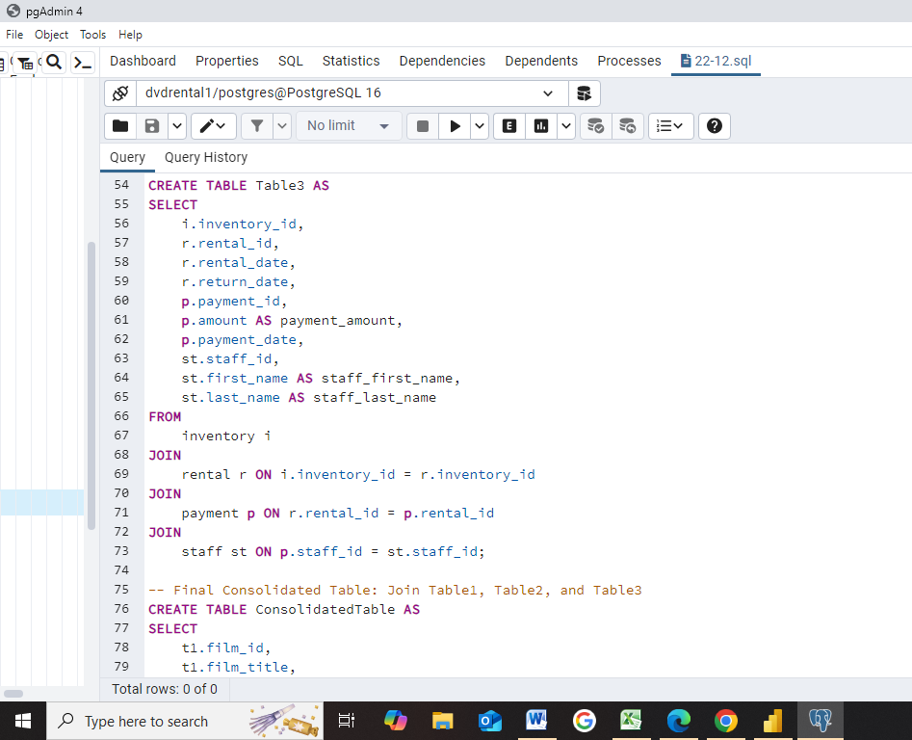
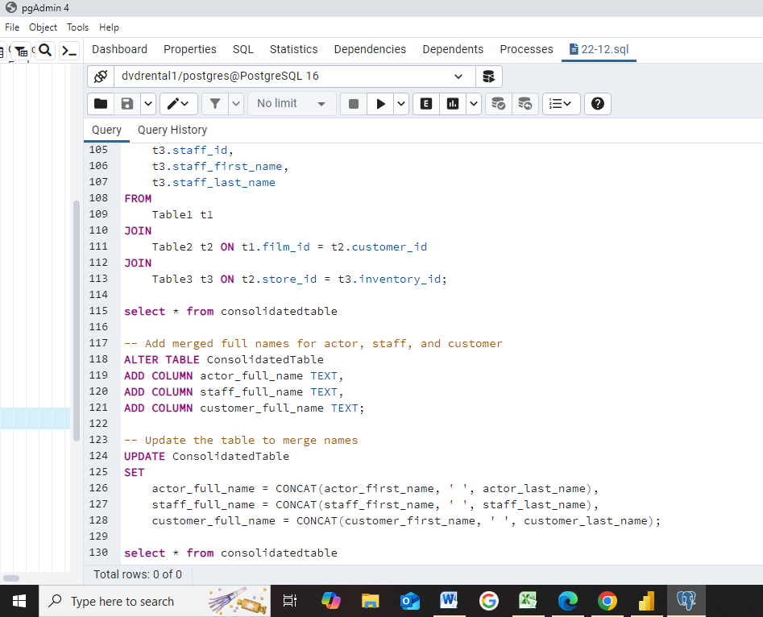

Slide 6

Consolidated Table link
data dvd finalproject.csv

Slide 7

Key Insights
Cross-Domain and Rental Trends Analysis
Rental and Payment Analysis
Customer Analysis
Film & Actor Analysis

Slide 8
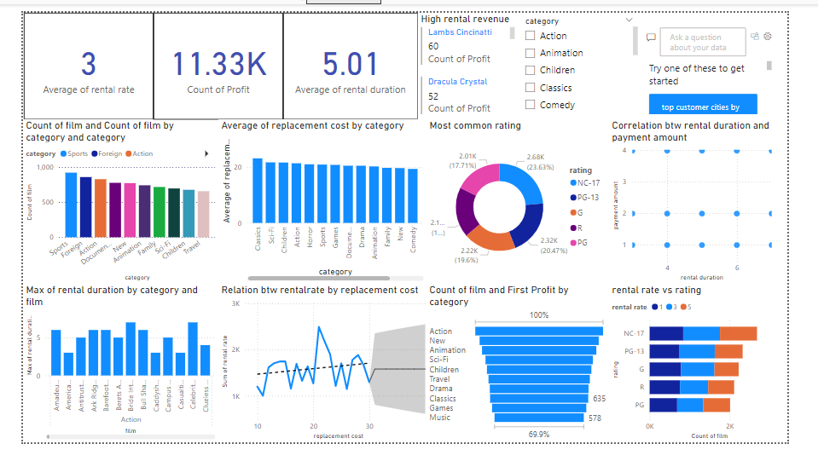

Slide 9
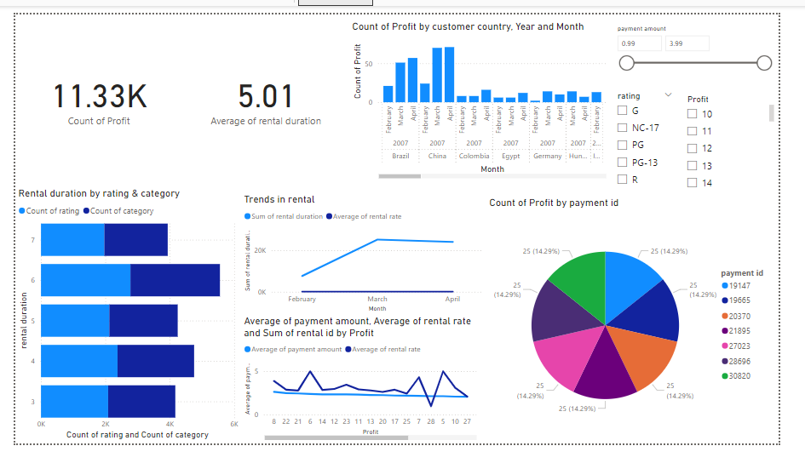

Slide 10
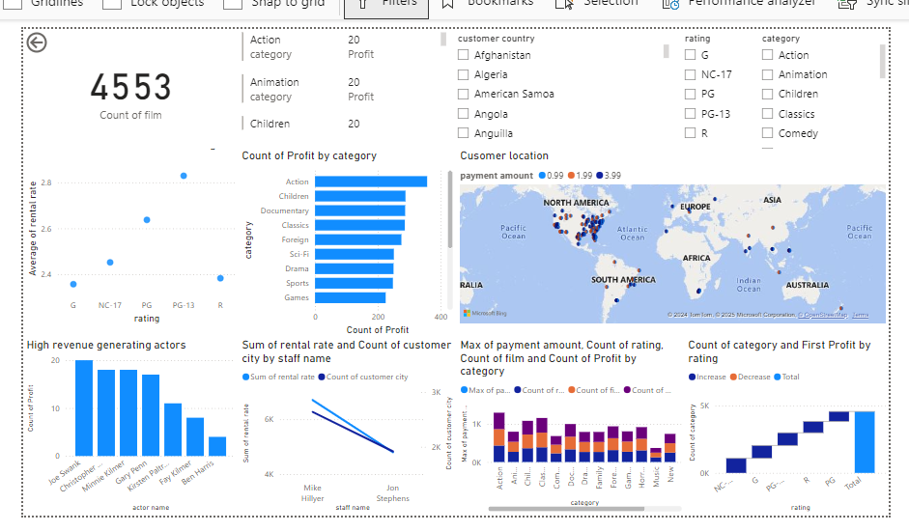

Slide 11
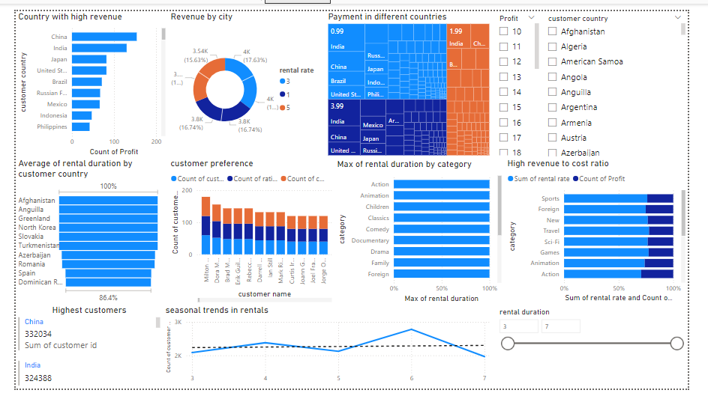

Slide 12

Important Insights
Top Revenue-Generating Films
Customer Location Analysis
Rental Patterns and Seasonal Trends
Popular Film Genres
Correlation Between Rental Rate and Payment Amount
Actor Popularity and Film Revenue

Slide 13
Suggestions
Optimize local promotions and offers for high-density areas.
Plan inventory and staffing during peak rental periods.
Acquire more films in high-demand genres to maximize rentals
Adjust pricing strategies for films to optimize revenue.
Reward top-performing staff or identify training needs for others.
Prioritize films featuring popular actors for promotions.

Slide 14
Conclusion
Replacement cost > Profit
Negative Correlation between Replacement Cost & Rental Rate
China has the largest number of customers whereas they should focus more on other countries.
Western significant growth in customer base in the northern region
Sport-loving customers - advisable to stock more sport-related films to increase total sales - increase average rental rate
India been the largest market in people and revenue

Slide 15

Thank you

